Slide 1

SQL Assignment By Shyma Asghar [July 2024]

Slide 2
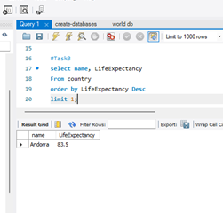
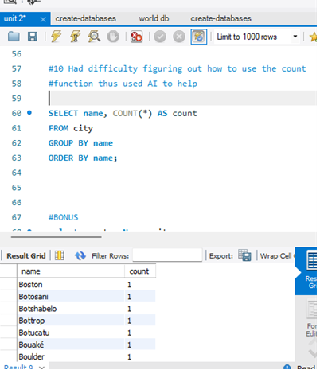
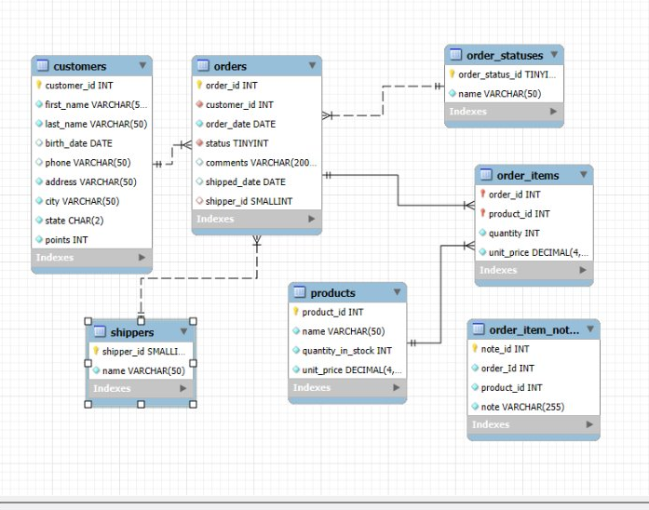
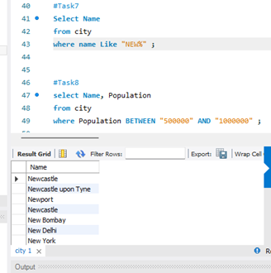
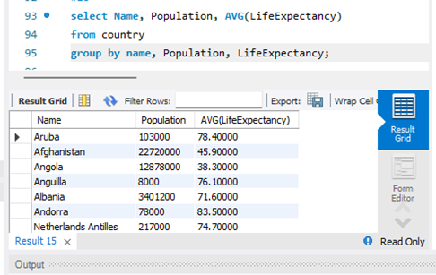
SQL Assignment Part (1) Highlights: July 2024

Slide 3
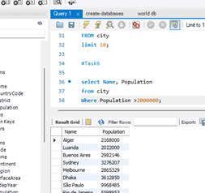
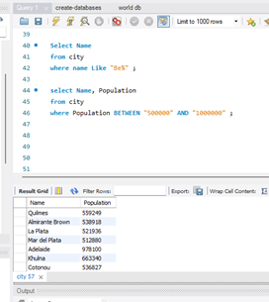
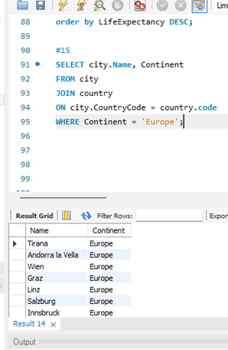
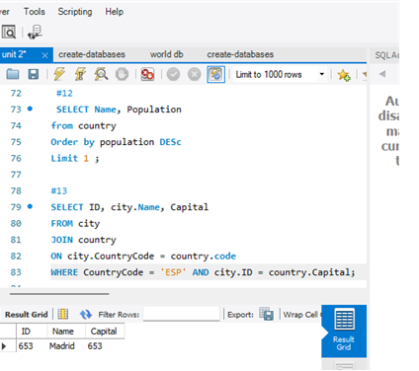
SQL Assignment Part (2) Highlights:​

Slide 4
Appendix:
SCRIPT (1):
USE sql_store; # database name
SELECT * # asterisk means all rows
FROM customers #column name
-- WHERE CUSTOMER_ID=1 #condition
ORDER BY first_name; #end with semi colon
SELECT last_name, first_name, points, (points + 10) * 100 AS discount_factor
FROM customers;
select name, unit_price
from products;
SELECT name, unit_price, unit_price *1.1 AS "new_price"
from products;
SELECT first_name, last_name, birth_date
from customers
Where birth_date > '1990-01-01';

Slide 5
Appendix
Script (2):
Select COUNT(name)
from city
Where countryCode= "USA";
select name, LifeExpectancy
From country
order by LifeExpectancy Desc
limit 1;
Select Name
from city
where name Like "NEW%" ;
SELECT ID, Name, Population
FROM city
limit 10;
select Name, Population
from city
Where Population >2000000;
Select Name
from city
where name Like "BE%" ;
select Name, Population
from city
where Population BETWEEN "500000" AND "1000000" ;
SELECT Name
FROM city
Order By Name ASC;
SELECT Name, Population
from city
Order by population DESc
Limit 1 ;
SELECT name, COUNT(*) AS count
FROM city
GROUP BY name
ORDER BY name;
SELECT Name, Population
from city
Order by population ASC
Limit 1 ;
SELECT Name, Population
from country
Order by population DESc
Limit 1 ;
SELECT ID, city.Name, Capital
FROM city
JOIN country
ON city.CountryCode = country.code
WHERE CountryCode = 'ESP' AND city.ID = country.Capital;
Select name, LifeExpectancy
from country
order by LifeExpectancy DESC;
SELECT city.Name, Continent
FROM city
JOIN country
ON city.CountryCode = country.code
WHERE Continent = 'Europe';
select Name, Population, AVG(LifeExpectancy)
from country
group by name, Population, LifeExpectancy;
SELECT city.Population, city.Name, country.Capital
FROM city
JOIN country
ON city.CountryCode = country.code
ORDER BY city.population DESC;
Select Population, name
from country
order by Population ASC;

